Slide 1
Mean first Passage Time Analysis
Giuseppe Sacco

Slide 2
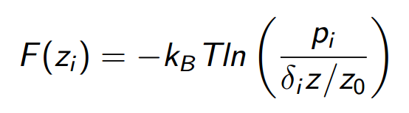
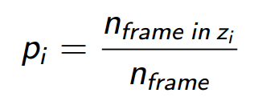
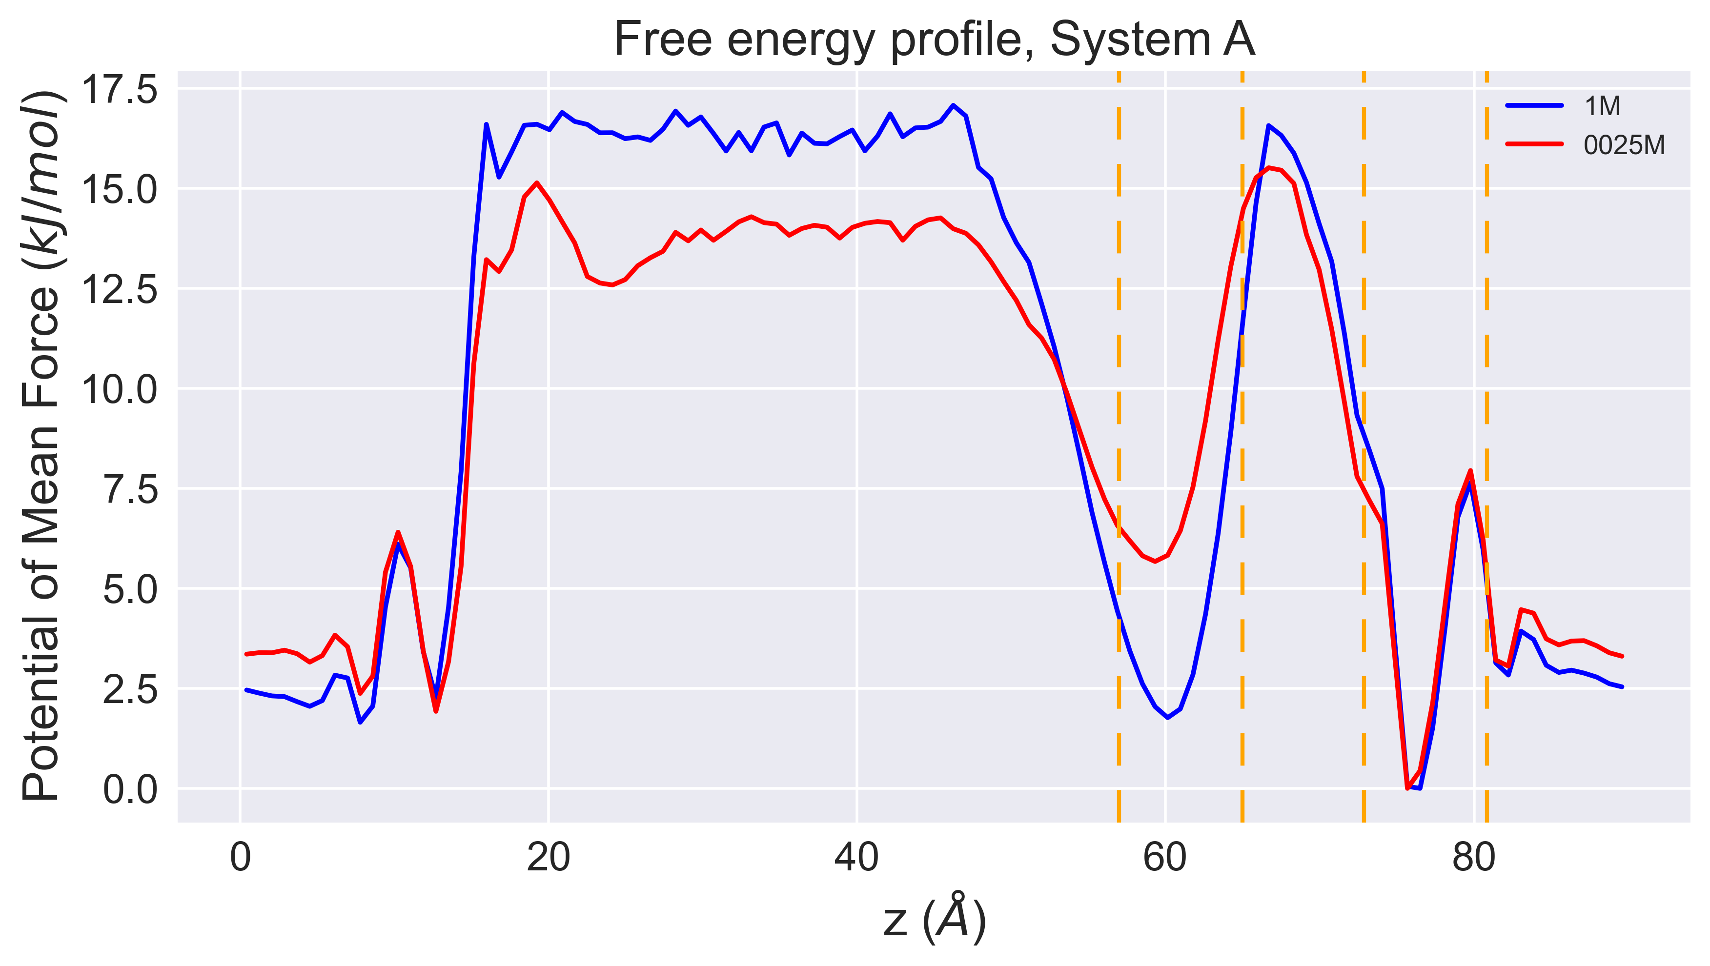
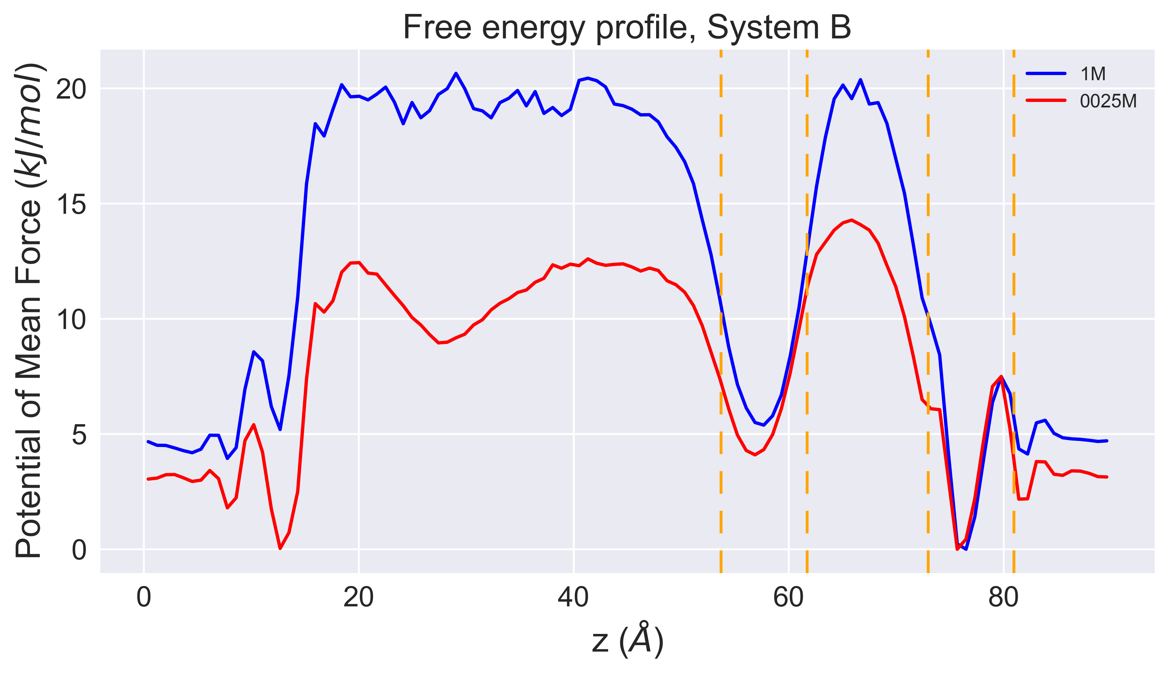
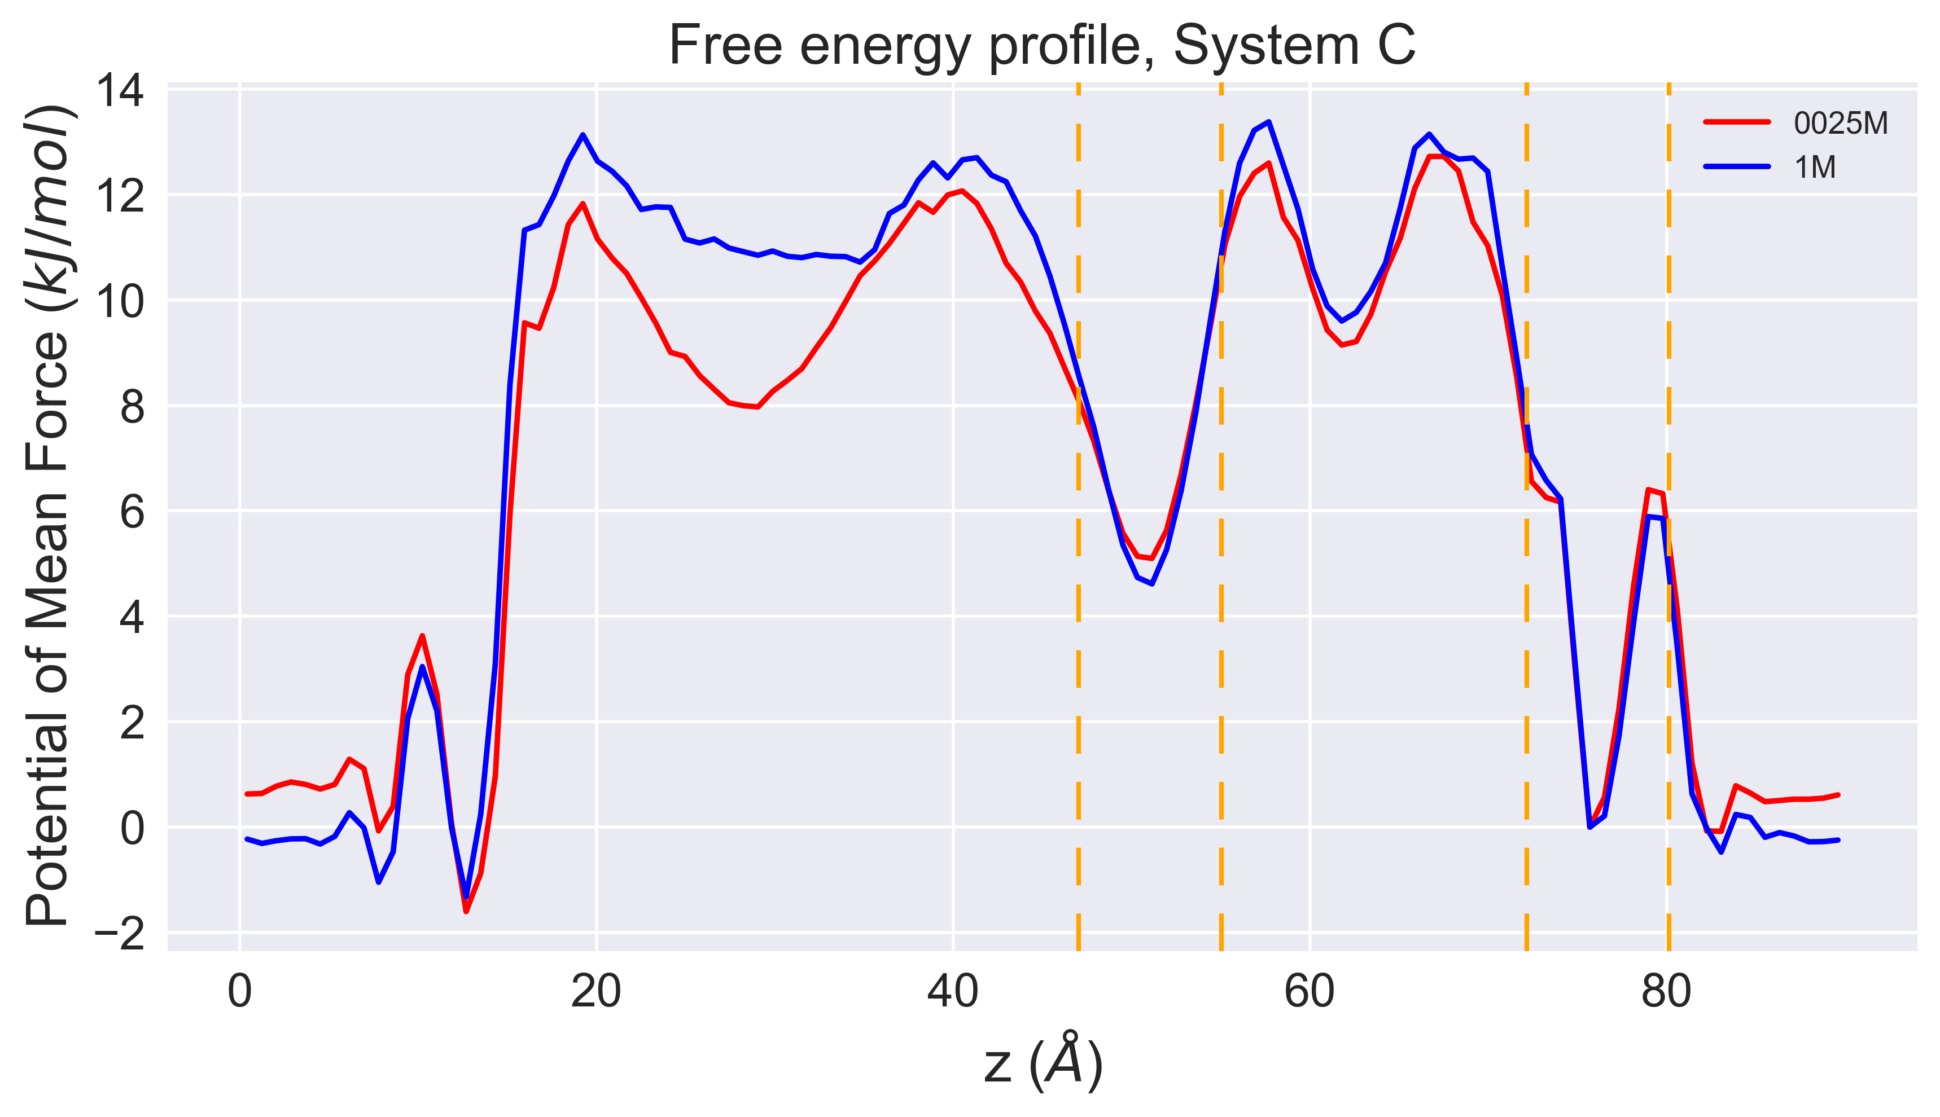
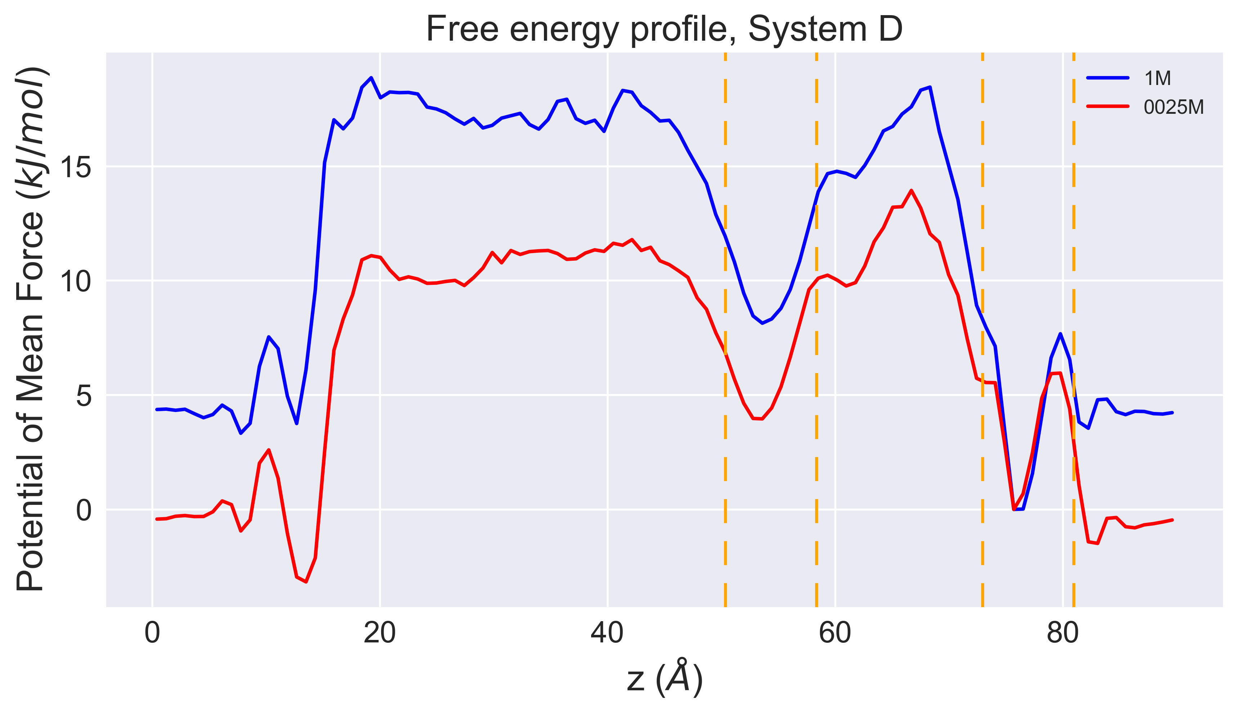
Free Energy Profile
4 systems
2 molarities:
0.0025M and 1M

Slide 3
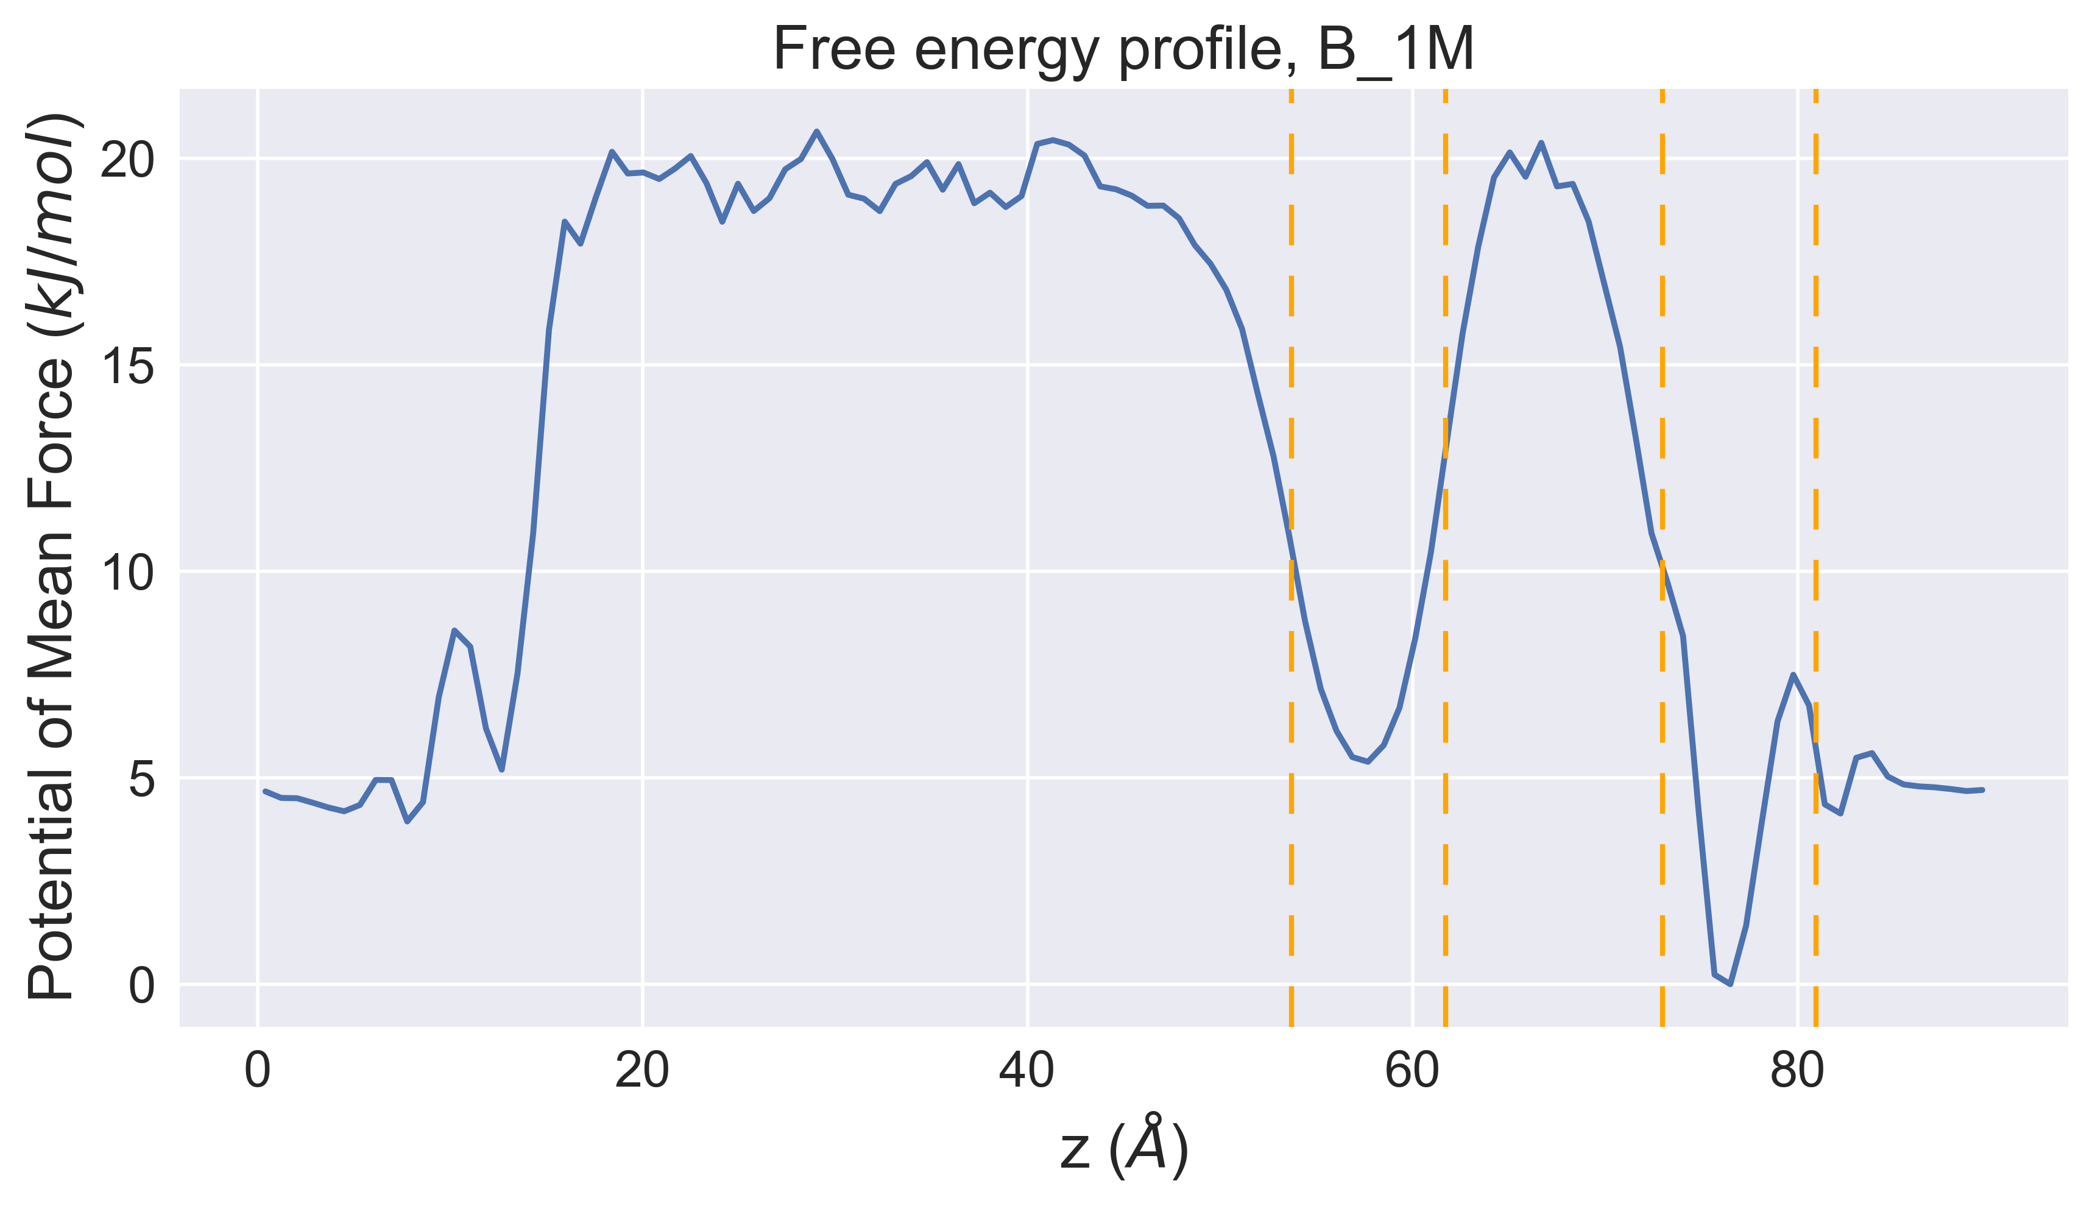
Mean First Passage Time
Two boxes are defined whose center corresponds to the local minima of the potential of mean force right before and after the nanotube entrance. The width of these boxes is chosen as a parameter.
Following the ion trajectory, each transition time is the computed as the residence time in the starting box before the transition to the second box. Transitions are considered valid only if, during the lag time,

Slide 4
Results obtained
Parameters used:
Width of box = 8.0 A
Lag time = 6.0 ps
Acceptance rate = 60%
System | Molarity | Transitions | MFPT | Tau | Delta Tau
A | 0025 | 86 | 1488 | 1330 | 192
 | 1 | 28 | 3596 | 2450 | 255
B | 0025 | 123 | 795 | 244 | 10
 | 1 | 13 | 15120 | 3098 | 679
C | 0025 | 98 | 513 | 160 | 13
 | 1 | 54 | 858 | 348 | 36
D | 0025 | 59 | 538 | 344 | 21
 | 1 | 32 | 5793 | 9897 | 4369
Time is expressed is ps
More transitions are observed for lower concentrations.

Slide 5
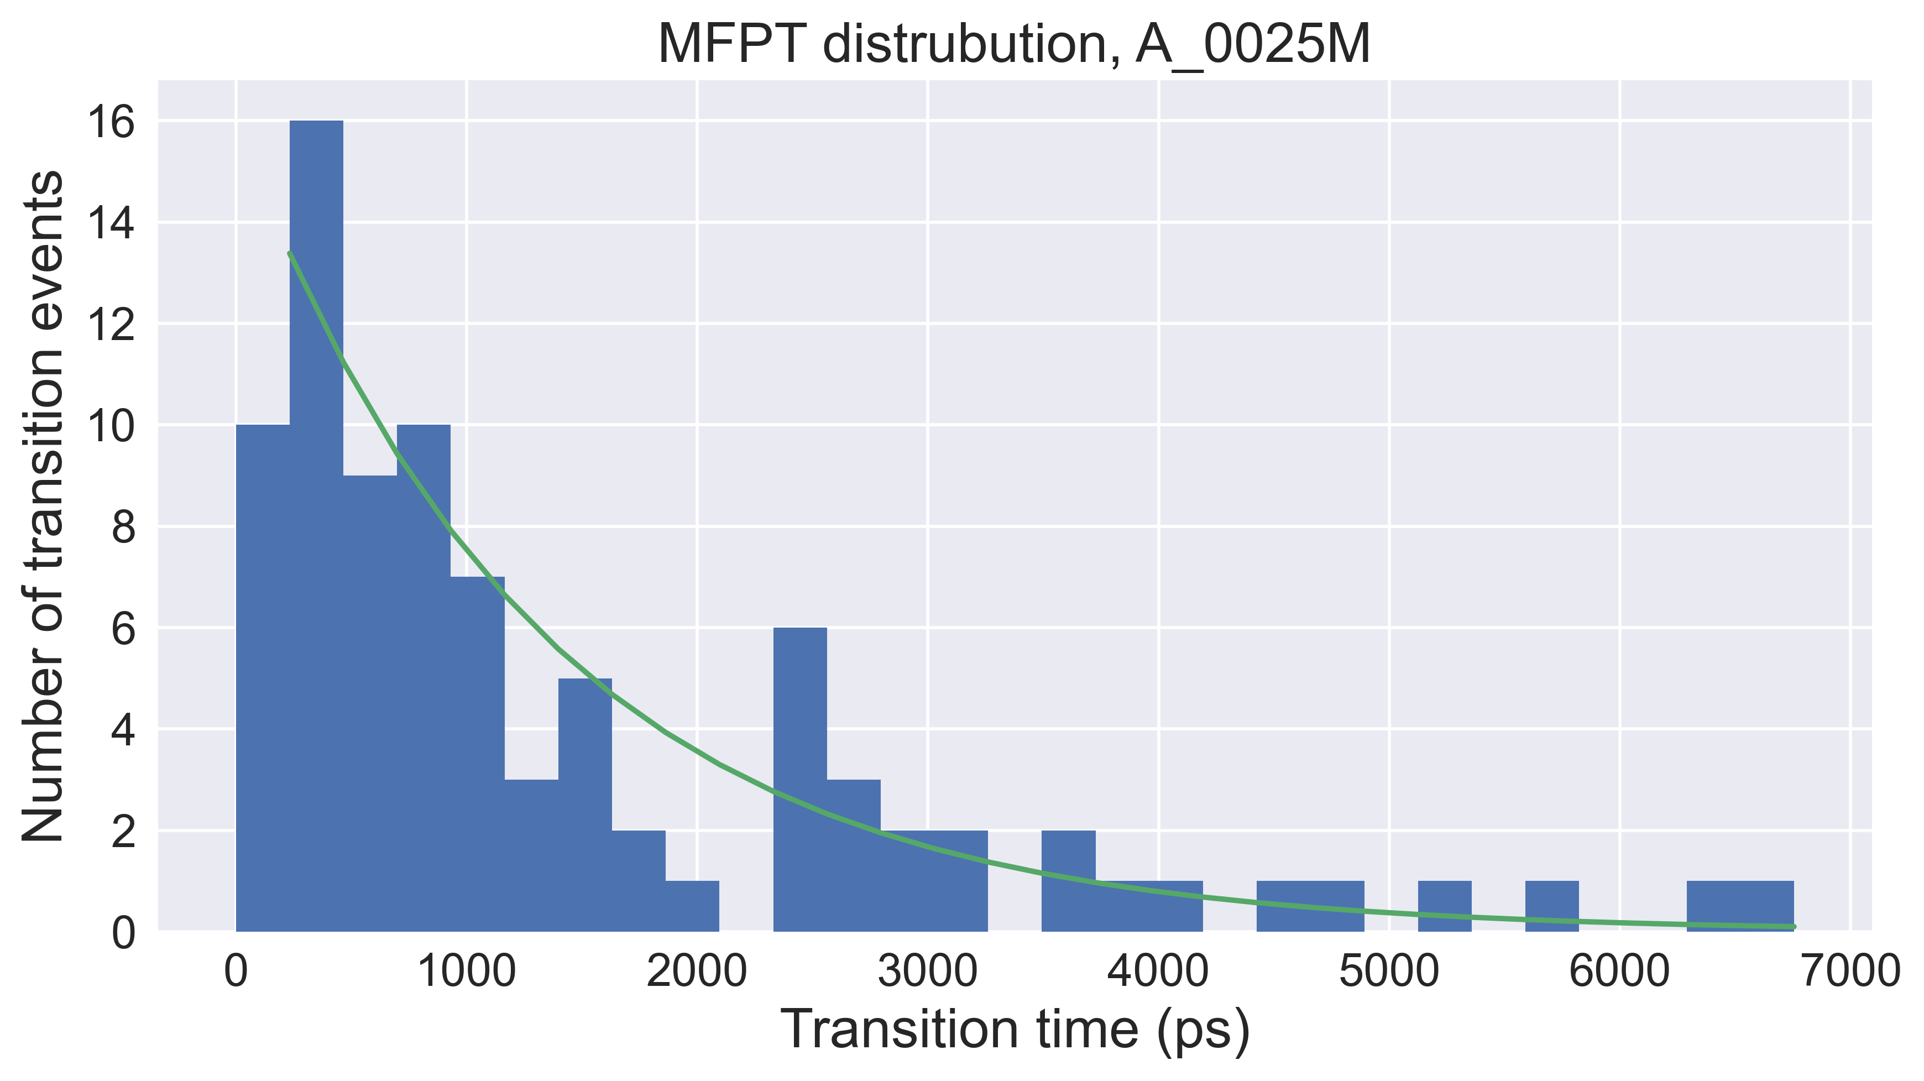
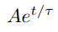
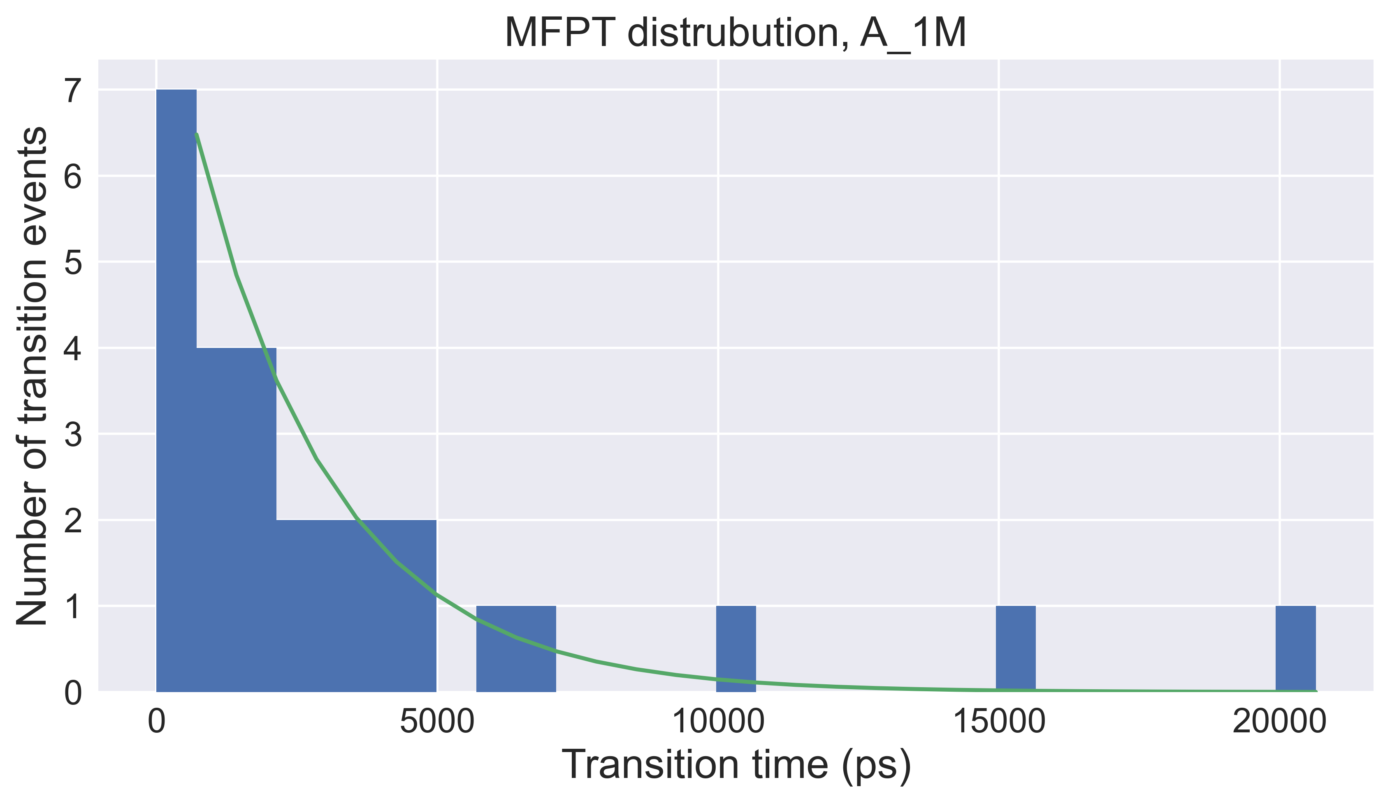
Fit of Tau
Sys. | Molarity | Trans. | MFPT | Tau | Tau st. Dev.
A | 0025 | 86 | 1488 | 1330 | 192
 | 1 | 28 | 3596 | 2450 | 255
B | 0025 | 123 | 795 | 244 | 10
 | 1 | 13 | 15120 | 3098 | 679
C | 0025 | 98 | 513 | 160 | 13
 | 1 | 54 | 858 | 348 | 36
D | 0025 | 59 | 538 | 344 | 21
 | 1 | 32 | 5793 | 9897 | 4369

Slide 6
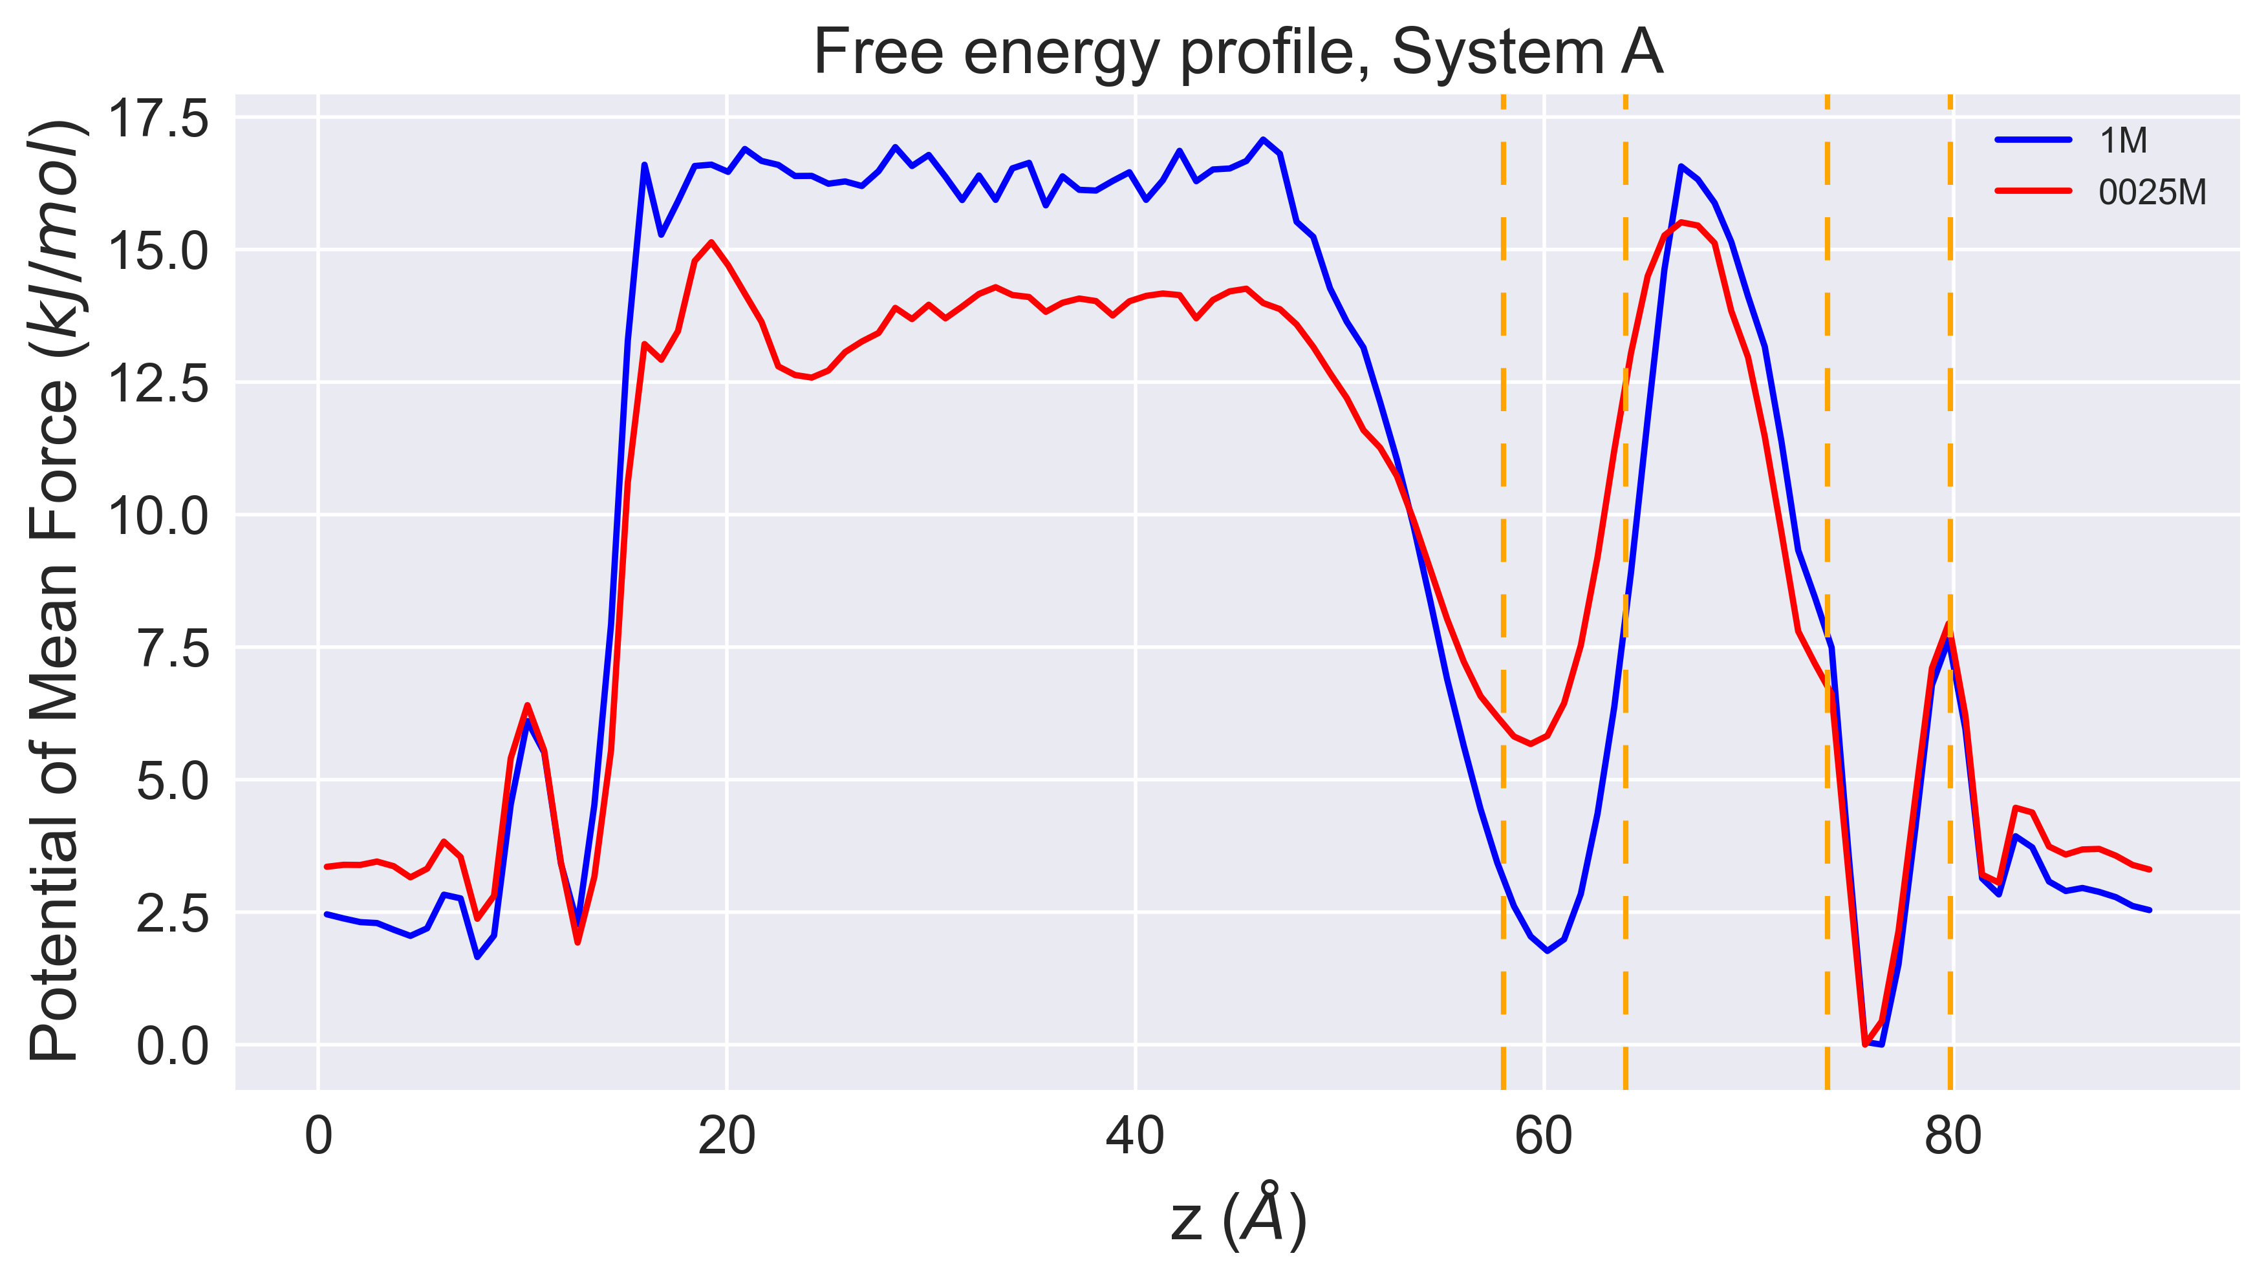



Umbrella Sampling
Decoupling of effects of charge and electric field

Slide 7
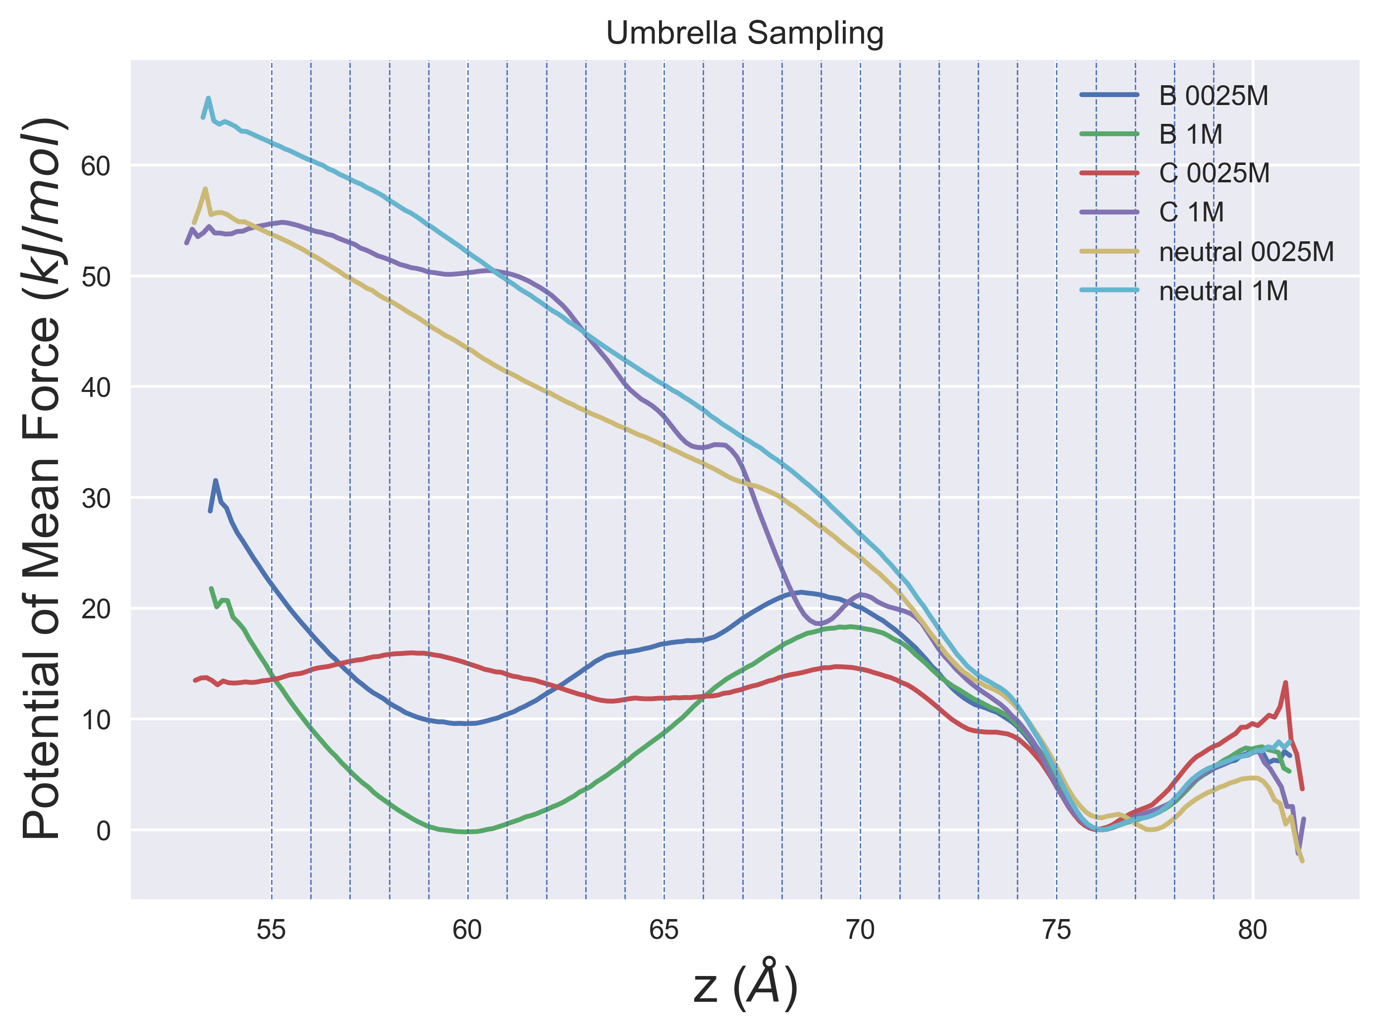
Umbrella Sampling
Decoupling effects of charge and electric field
25 configurations equally spaced (1A) from 79 to 55
No electric field applied
Differences due to molarity are observed

Slide 8
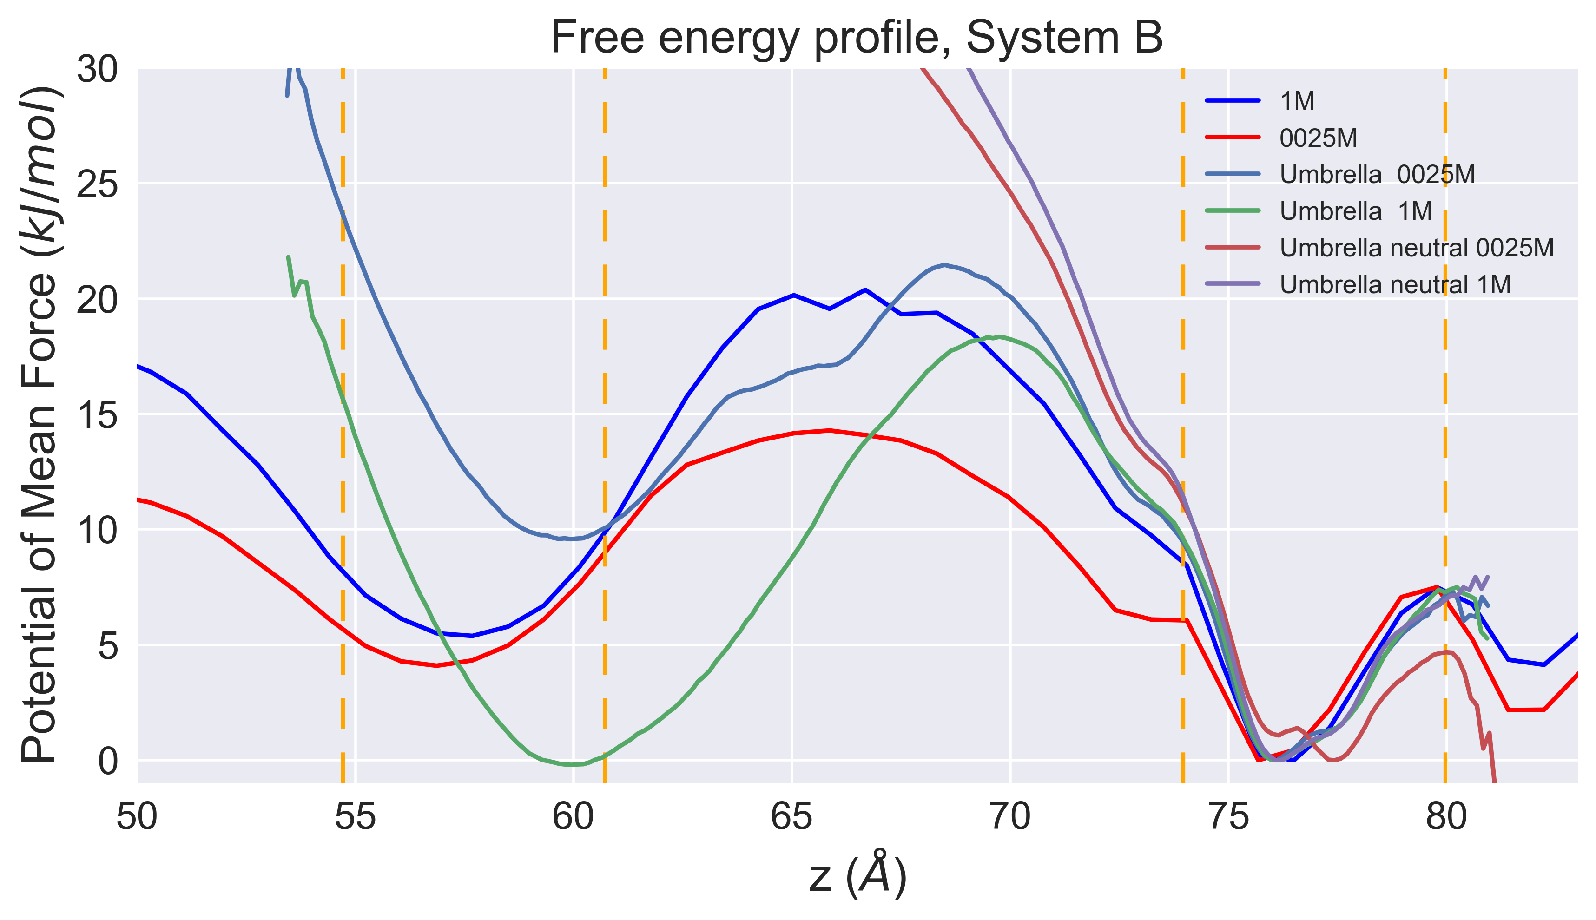
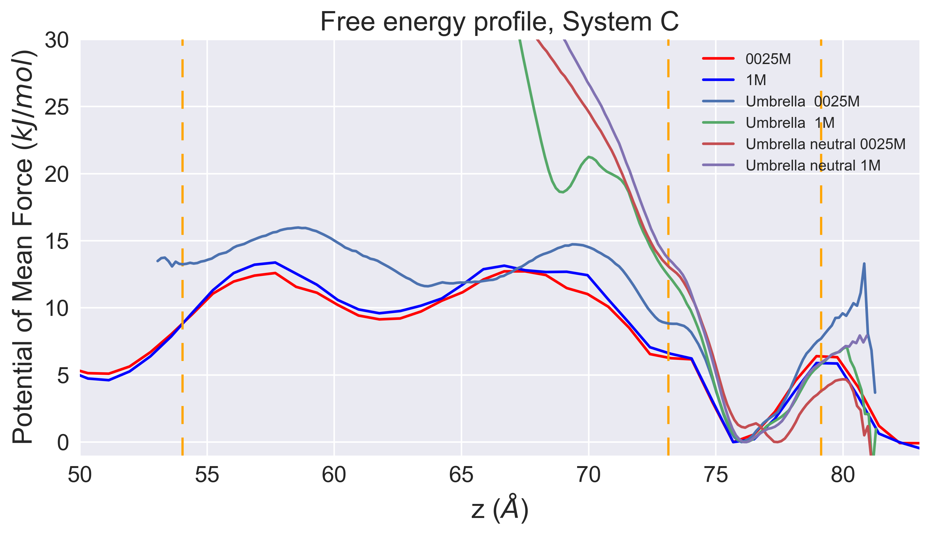
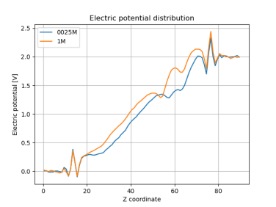
Umbrella Sampling

Slide 9
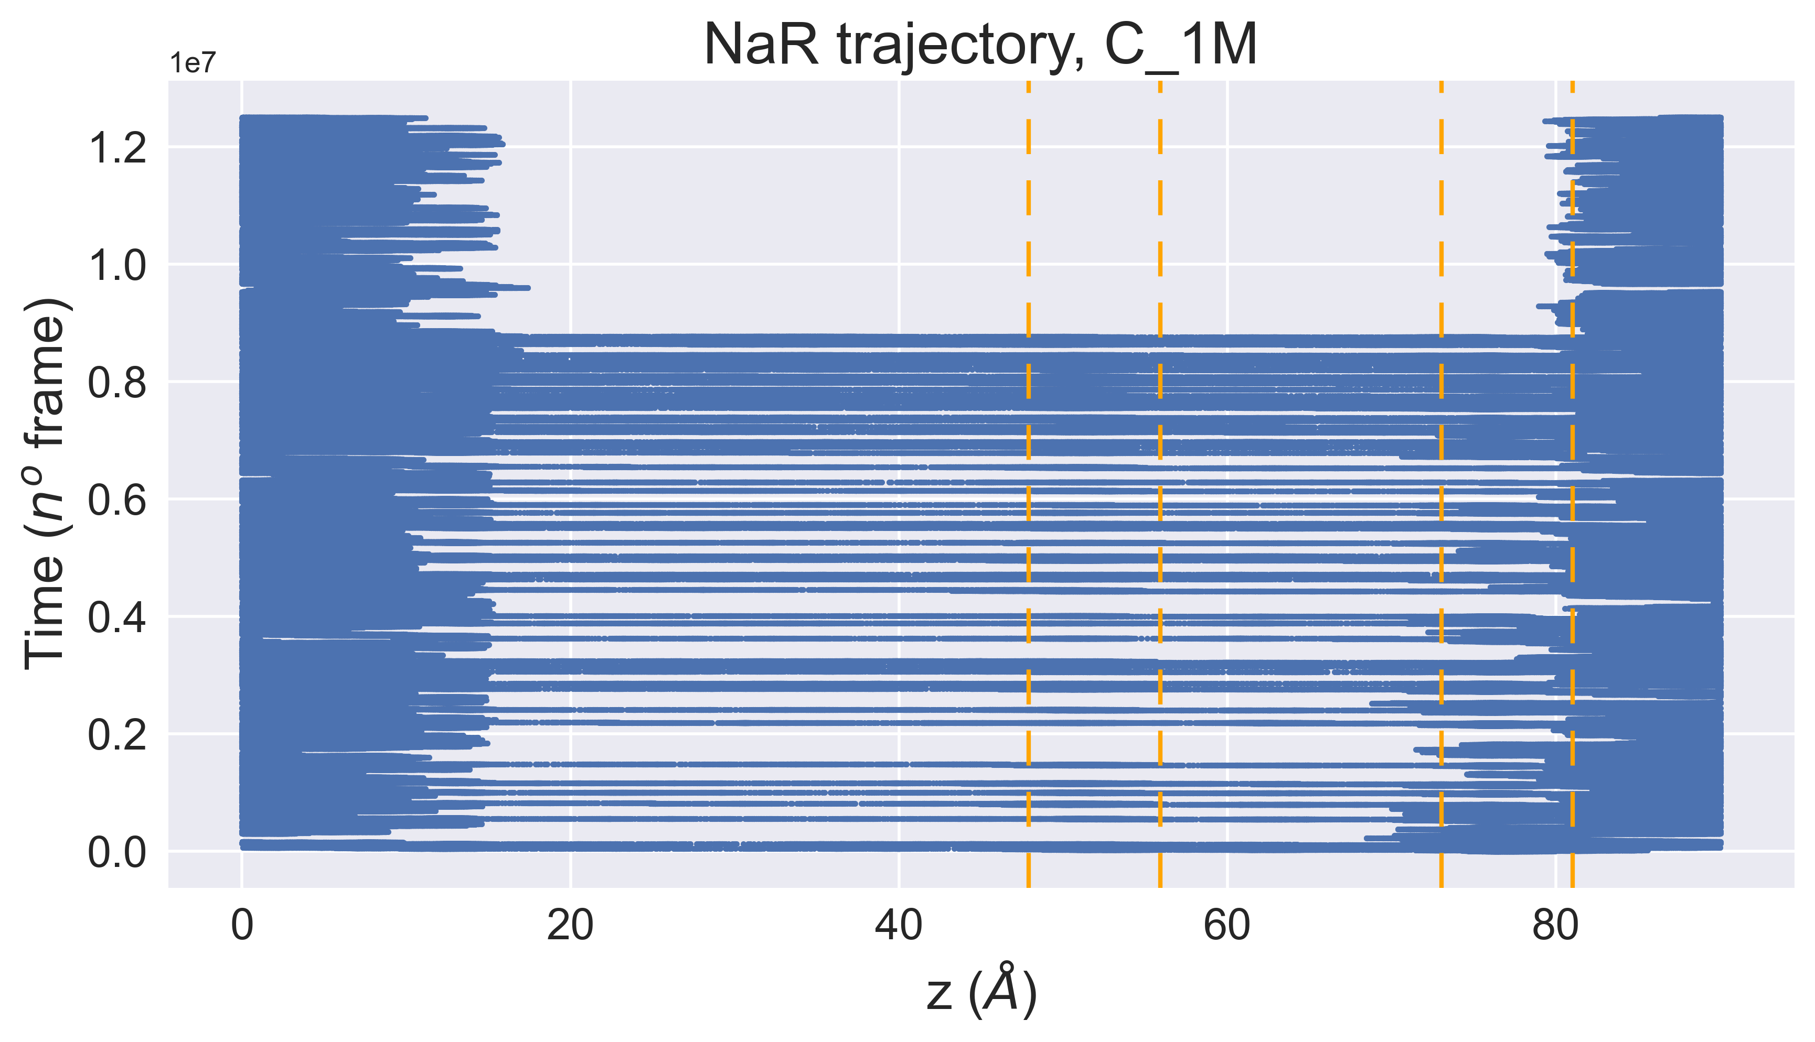
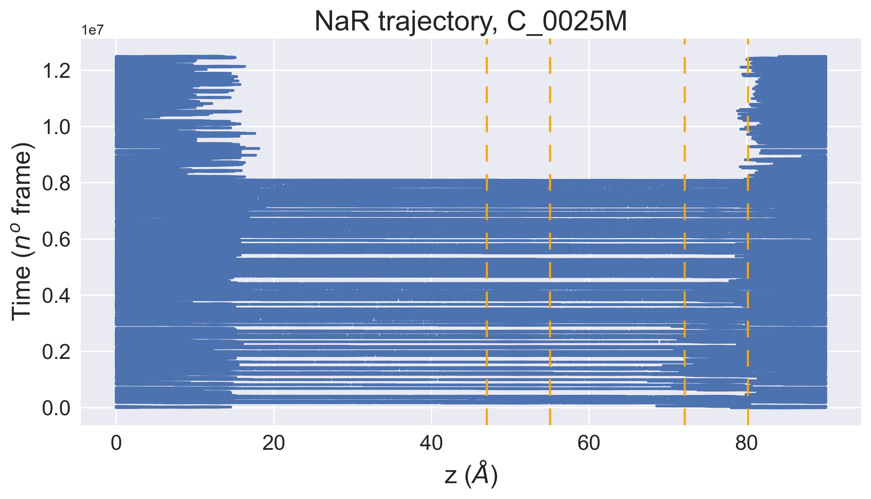
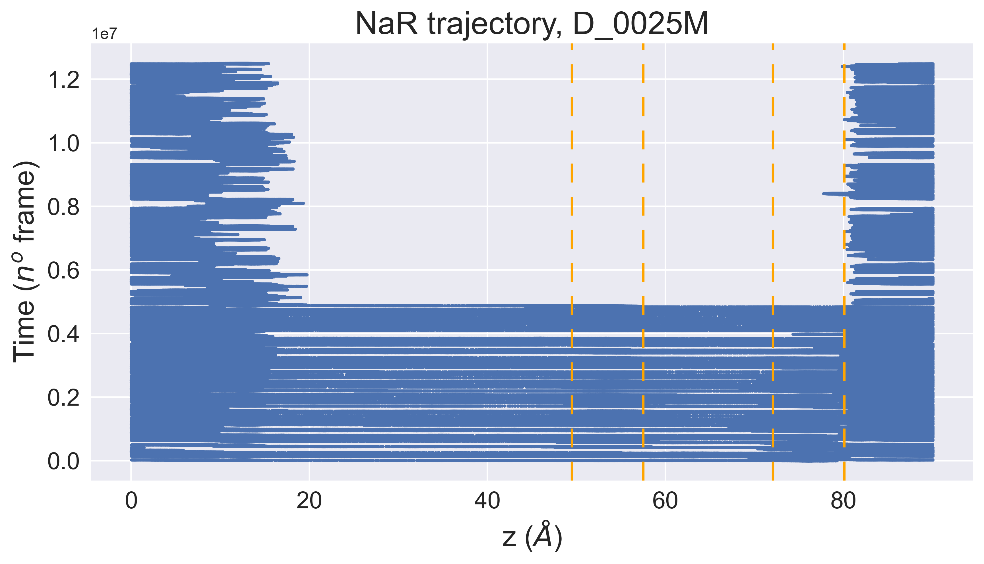
Future Developments
Algorithm for MFPT computation
Longer simulations to get better statistics
Improve fit of tau
Interpretation of umbrella sampling results

